Slide 1
Voting Ensembles

Slide 2
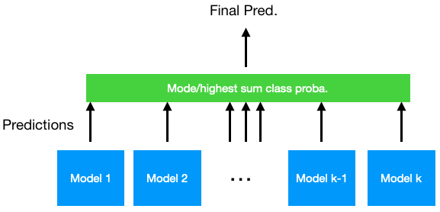
Voting Classifiers
Several ML models, final prediction is
Hard voting: mode of individual predictions
Soft voting: highest sum class probabilities across all classes
Notes:
Photo: https://www.flickr.com/photos/107442568@N08/12547327134

Slide 3
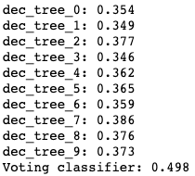
Voting Classifiers
Several ML models, final prediction is
Hard voting: mode of individual predictions
Soft voting: highest sum class probabilities across all classes
Notes:
Photo: https://www.flickr.com/photos/107442568@N08/12547327134

Slide 4
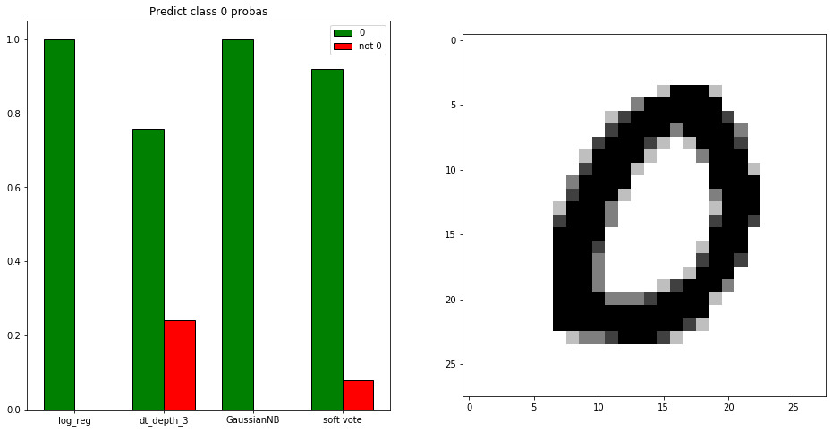
Voting Classifiers
Several ML models, final prediction is
Hard voting: mode of individual predictions
Soft voting: highest sum class probabilities across all classes
Notes:
Photo: https://www.flickr.com/photos/107442568@N08/12547327134

Slide 5
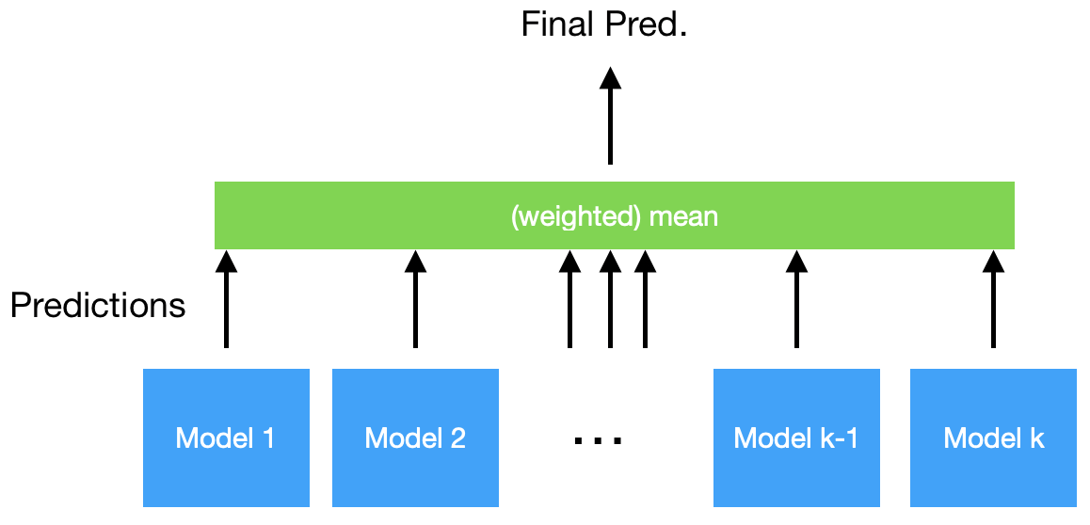
Voting Regressor
Several ML models, final prediction is
Take the mean value of all regression output
Notes:
Photo: https://www.flickr.com/photos/107442568@N08/12547327134

Slide 6
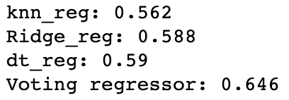
Voting Regressor
Several ML models, final prediction is
Take the mean value of all regression output
Notes:
Photo: https://www.flickr.com/photos/107442568@N08/12547327134

